Slide 1
Sales pitch
Subtitle goes

Slide 2
Hyperrail Project
Project goals:
Create a modular, inexpensive method to analyze crops using hyperspectral imaging
Have an easy to use interface for general use (greenhouse technicians, RA’s, etc)
Document project details for future iterations
Current project iteration is to use a gantry
Project implemented 2 axes with plans in place for a 3rd
Custom firmware written for Adafruit Feather M0 with stepper drivers
UI implemented in Processing
Project support from the OPeNs Lab (Openly Published Environmental Sensing)

Slide 3
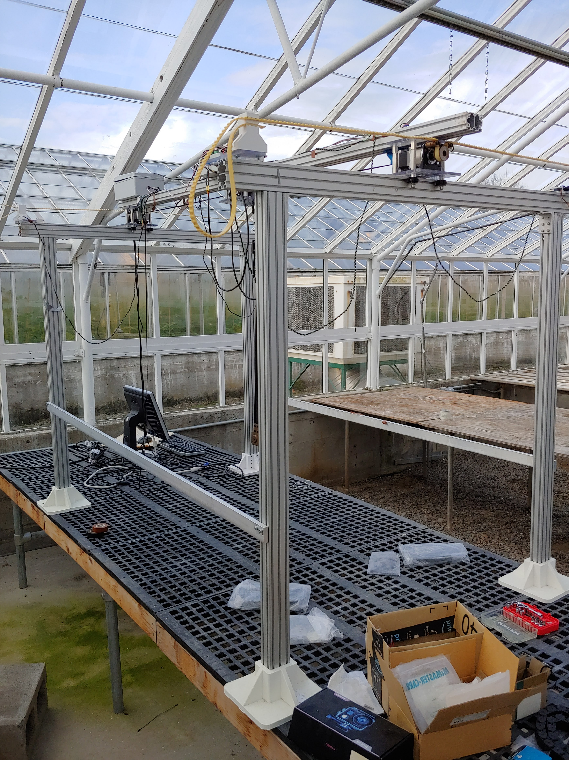
System as-is

